Slide 1
Arrays in Java

Slide 2
Array – 1D and Multidimensional
Enhanced for loop
Array with Classes
Var-Arg

Slide 3
Arrays in Java
In Java, all arrays are dynamically allocated.
Arrays are stored in contagious memory [consecutive memory locations].
Since arrays are objects in Java, we can find their length using the object property length.
A Java array variable can also be declared like other variables with [] after the data type.
The variables in the array are ordered, and each has an index beginning from 0.
Java array can also be used as a static field, a local variable, or a method parameter.
The size of an array must be specified by int or short value and not long.
This storage of arrays helps us in randomly accessing the elements of an array [Support Random Access].
The size of the array cannot be altered(once initialized).
However, an array reference can be made to point to another array.

Slide 4
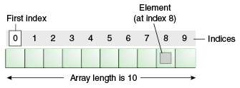
Arrays in Java
Advantages
Code Optimization: It makes the code optimized, we can retrieve or sort the data efficiently.
Random access: We can get any data located at an index position.
Disadvantages
Size Limit: We can store only the fixed size of elements in the array.
It doesn't grow its size at runtime.
To solve this problem, collection framework is used in Java which grows automatically.

Slide 5
Types of arrays
There are two types of array.
Single Dimensional Array
Multidimensional Array
Syntax to Declare an Array in Java
dataType[] arr; (or)
dataType []arr; (or)
dataType arr[];
Instantiation of an Array in Java
arrayRefVar=new datatype[size];

Slide 6
Accessing array with enhanced for loop
/*To initialise an array with 10 elements and print only even elements*/
class even_array{
static int [] num={10,2,3,5,7,11,12,56,80,45};
public static void main(String [] args){
for (int i:num){
if (i%2==0)
System.out.println(i);
}
}
}

Slide 7
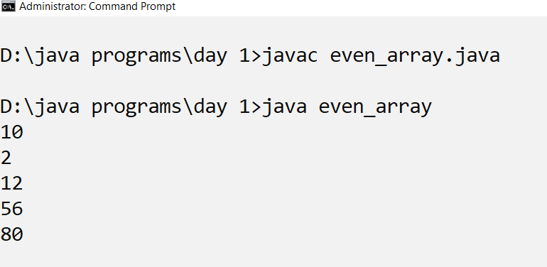
output

Slide 8
Accessing array with ordinary for loop
/*To initialise an array with 10 elements and print only even elements*/
class even_array_loop{
static int [] num={10,2,3,5,7,11,12,56,80,45};
public static void main(String [] args){
for(int i=0;i<=num.length-1;i++){
if (num[i]%2==0)
System.out.println(num[i]);
}
}
}

Slide 9
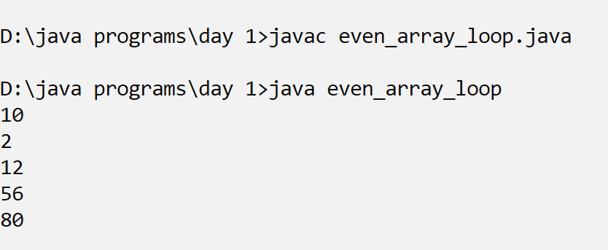
output

Slide 10
What happens if we try to access elements outside the array size?
JVM throws ArrayIndexOutOfBoundsException to indicate that the array has been accessed with an illegal index.
The index is either negative or greater than or equal to the size of an array.

Slide 11
Arrays with classes
An array of objects is also created like an array of primitive type data items.

Slide 12
Creating parameterized constructor
class emp_arr{
int empid;
String empname;
String designation;
emp_arr(int eid,String ename, String d){
this.empid=eid;
this.empname=ename;
this.designation=d;
}

Slide 13
Display method
public void disp(){
System.out.println("Empid:"+this.empid);
System.out.println("Empname:"+this.empname);
System.out.println("designation:"+this.designation);
}

Slide 14
Main method
public static void main(String [] args) throws Exception{
emp_arr [] e= new emp_arr[3];
for(int i=0;i<=e.length-1;i++){
DataInputStream in=new DataInputStream(System.in);
int eid=Integer.parseInt(in.readLine());
String name=in.readLine();
String designation=in.readLine();
e[i]=new emp_arr(eid,name,designation);
}//for
for(emp_arr i:e){
i.disp();
}

Slide 15
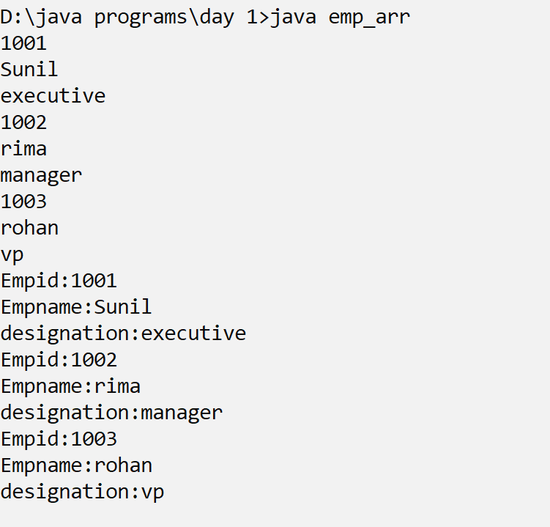
output

Slide 16
Multidimensional Arrays:
Multidimensional arrays are arrays of arrays with each element of the array holding the reference of other arrays.
These are also known as Jagged Arrays.
A multidimensional array is created by appending one set of square brackets ([]) per dimension.

Slide 17
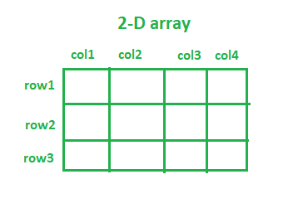
2-D array

Slide 18
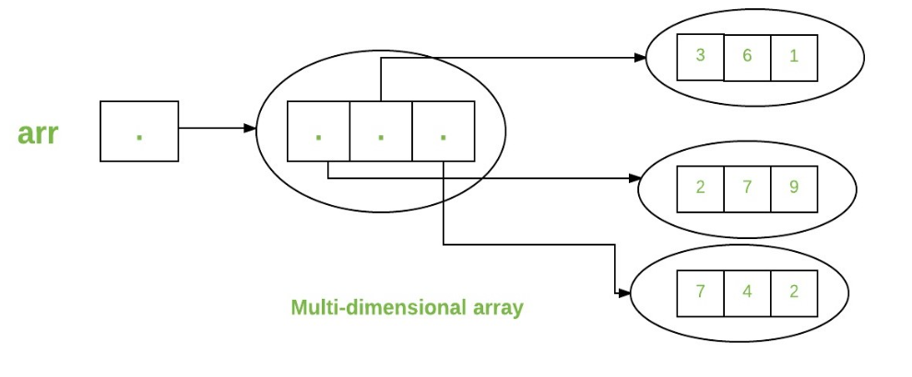
Multi-dimensional array(jagged array)

Slide 19
Creating a double dimensional array
data_type[][] array_Name = new data_type[no_of_rows][no_of_columns];
The total elements in any 2D array will be equal to (no_of_rows) * (no_of_columns).
no_of_rows: The number of rows an array can store. e.g. no_of_rows = 3, then the array will have three rows.
no_of_columns: The number of rows an array can store. e.g. no_of_columns = 4, then the array will have four columns.
int[][] intArray = new int[10][20]; //a 2D array or matrix
int[][][] intArray = new int[10][20][10]; //a 3D array

Slide 20
/*squaring of matrix using getter setter methods*/
class mat{
int [][] x=new int [2][2];
public int [][] getX(){
return x;
}

Slide 21
Assigning value to the matrix
public void setX(int [][] new_x){
for(int i=0;i<=x.length-1;i++)
{
for (int j=0;j<=x[i].length-1;j++){
x[i][j]=new_x[i][j]*new_x[i][j];
}//for
}//for
}//setx
}//class mat

Slide 22
Initialising a matrix in the main class
class mat_main{
public static void main(String [] args){
mat m=new mat();
int [][] m1={{2,4},{3,6}};
m.setX(m1);
System.out.println("printing original matrix");
for(int i=0;i<=m1.length-1;i++)
{
for (int j=0;j<=m1[i].length-1;j++){
System.out.println(m1[i][j]);
}//for
}//for

Slide 23
Retireving the value of the matrix
int [][] m2=m.getX();
System.out.println("printing square matrix");
for(int [] row:m2){
for(int col: row){
System.out.println(col);
}//for row
}//for col
}//main
}//class mat_main

Slide 24
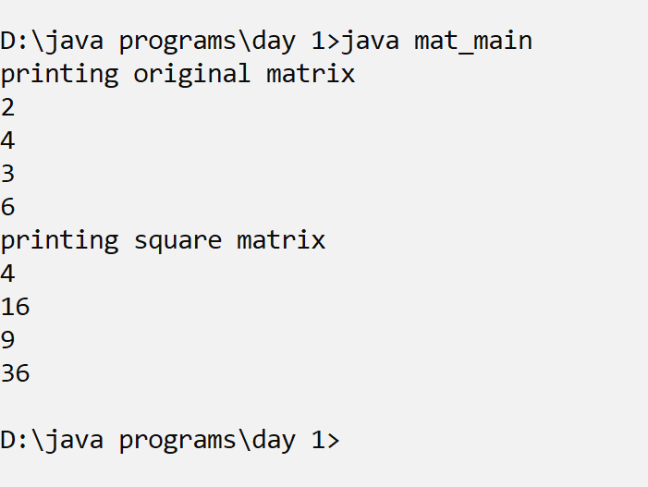
output

Slide 25
Var-arg in java
Variable Arguments (Varargs) in Java is a method that takes a variable number of arguments. Variable Arguments in Java simplifies the creation of multiple methods that need to take a variable number of arguments.

Slide 26
Syntax
public static void fun(int ... a)
{
// method body
}

Slide 27
Printing the sum of a variable list
class sum_list{
int sum(int ... x){
int s=0;
for(int i: x){
s=s+i;
}
return s;
}
}

Slide 28
Printing the sum of a variable list
class sum_list_main{
public static void main(String [] args){
sum_list sl=new sum_list();
System.out.println(sl.sum(10,20));
System.out.println(sl.sum(1,2,3));
int [] x={100,203,45,67};
System.out.println(sl.sum(x));
}
}

Slide 29
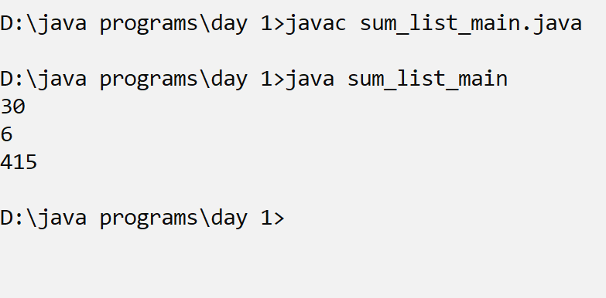
Sum of list

Slide 30
Thank you

